Slide 1
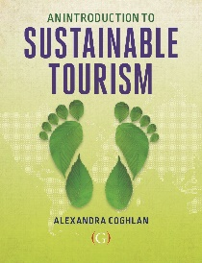

Challenges to sustainable tourism
Lecture 2
© Alexandra Coghlan 2019 Introduction to Sustainable Tourism

Slide 2
Overview – is tourism sustainable?
Reminder of the definition of sustainable tourism
The size of the sector
Challenges facing sustainable tourism
CLIMATE CHANGE
© Alexandra Coghlan 2019 Introduction to Sustainable Tourism

Slide 3
Sustainable Tourism
= tourism development that meets the needs of the present without compromising the ability of future generations to meet their own needs.
© Alexandra Coghlan 2019 Introduction to Sustainable Tourism

Slide 4
Sustainable Tourism should
1. Make optimal use of environmental resources that constitute a key element in tourism development, maintain essential ecological processes and help to conserve natural heritage and beauty
2. Respect the socio-cultural authenticity of host communities, conserve their built and living cultural heritage and traditional values and contribute to their inter-cultural understanding and tolerance.
3. Ensure viable, long-term economic operations, providing socio-economic benefits to all stakeholders that are fairly distributed, including stable employment, and income earning opportunities and social services to host communities and contributing to poverty alleviation.

Slide 5
Global tourism: size (demand & supply)
Concept | Basis & Scope | Use and Limitations
The tourism industry is everything linked with tourism | All activities of all tourists are inferred to reflect ‘the industry’ | Useful as a measure of tourism’s economic impact, but misleading as a guide for management, policy, planning and sustainable tourism
Tourism industries as collections of organisations in the business of tourism, working cooperatively to some degree and possibly competing | Any such industry includes only organisations with business strategies focused on tourists and with linkages via managed cooperative networks | Useful as a guide for management, policy, planning and sustainable tourism. It reduces the size and importance of tourism industries, but not of tourism. It is difficult to identify and measure such industries, as every supplier must be assessed
© Alexandra Coghlan 2019 Introduction to Sustainable Tourism

Slide 6


Is tourism currently sustainable ?
© Alexandra Coghlan 2019 Introduction to Sustainable Tourism

Slide 7
If not, why not?
The private/public sector nature of tourism
-> “enlightened self-interest”
The scale-related issues of tourism
The issue of inseperability
The infrequent nature of tourism purchases
The “footloose” nature of much of the sector
The influence of business size on sustainability practices.
The need for local, context-based, yet multi-disciplinary knowledge
© Alexandra Coghlan 2019 Introduction to Sustainable Tourism

Slide 8
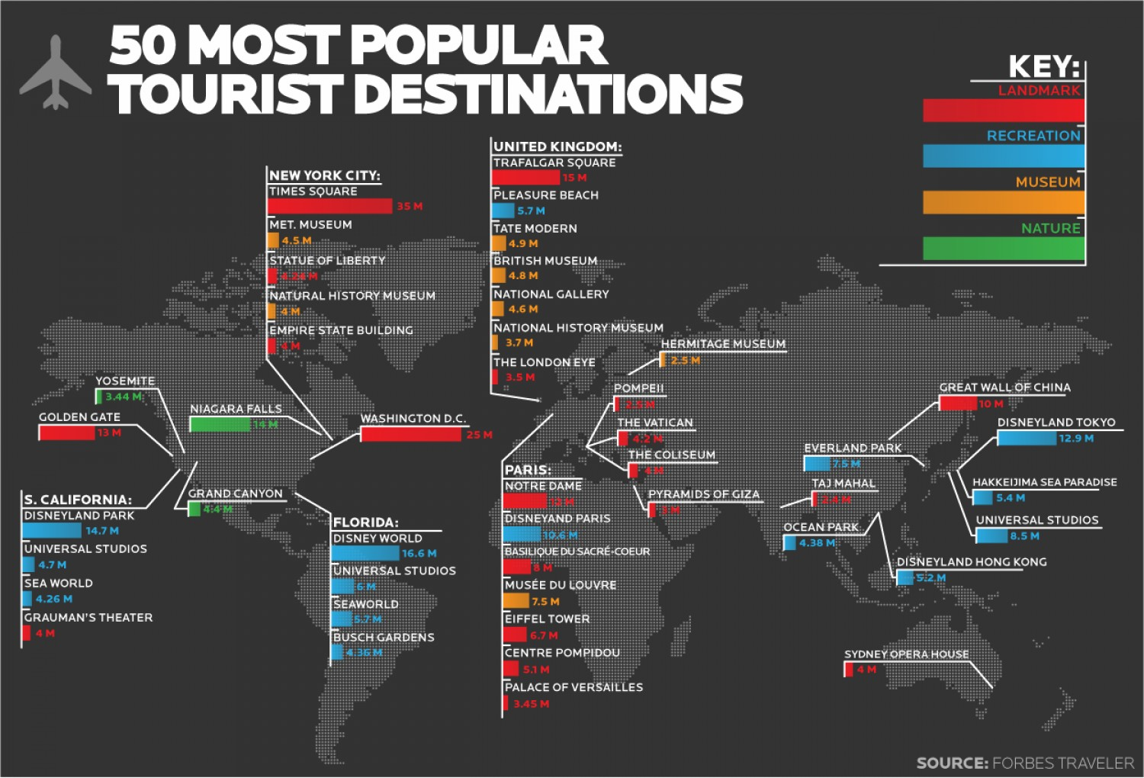
Challenge 1: Private/Public sector
© Alexandra Coghlan 2019 Introduction to Sustainable Tourism

Slide 9


Challenge 1, continued
© Alexandra Coghlan 2019 Introduction to Sustainable Tourism
Tourism is a fragmented sector
Many tourism attractions are held in public trust, but access is controlled by private sector
Problem of tragedy of the commons
No clear responsibility or accountability
The business case for sustainability?

Slide 10
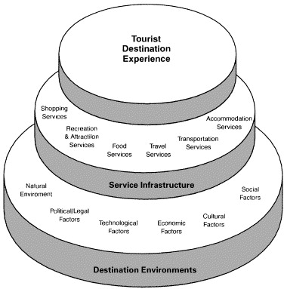
Challenge 2: issues of scale
Geographic: the global-local nexus
Political
Temporal
© Alexandra Coghlan 2019 Introduction to Sustainable Tourism

Slide 11
Challenge 3: Inseparability
Tourism experiences are co-produced by the supplier and consumer
no one person is responsible for tourism sustainability (unlike certified organic or fairtrade produce)
Tourists play an active role in sustainability:
Tourists consume more and recycle/re-use less when on holiday than at home
Tourist behaviour can account for over 50% of energy consumption in accommodation
Tourism behaviour will have a direct impact on social and environmental sustainability
“But I am on holiday!”
© Alexandra Coghlan 2019 Introduction to Sustainable Tourism

Slide 12



Challenge 4: Infrequency of tourism purchases
We struggle to understand, assess and weigh up sustainability of tourism
What is the first thing you check when deciding on a tourism purchase?
Also, search for NEWNESS and ESCAPISM
Sustainable tourism labels – do they work?
- reliability?
- transparency?
- auditing?
- enforcement?
© Alexandra Coghlan 2019 Introduction to Sustainable Tourism

Slide 13
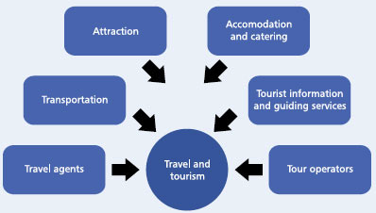
Challenge 5: Footloose nature of tourism
Only attractions(public domain) and accommodation and catering are tied to location
Others can move on to a new destination
Coordinating
Sector
Marketing
Specialists
© Alexandra Coghlan 2019 Introduction to Sustainable Tourism

Slide 14
Challenge 6: predominance of SMEs
Fewer resources to implement sustainability
Lack of technical expertise
Lack of purchasing power/economies of size
Does not mean that SMEs are not willing to engage in sustainability, but we do need to break down barriers.
Importance of regional “sustainability clusters”…
© Alexandra Coghlan 2019 Introduction to Sustainable Tourism

Slide 15
Challenge 7: Technical expertise vs local knowledge
A need for standardised information
vs a need for bespoke solutions?
An industry with low technical expertise, few “spare” resources and high staff turnover needs to predict impacts, measure indicators and implement solutions
THAT ARE SUITED TO THEIR ENVIRONMENT, THEIR BUSINESS, THEIR CLIENTS, THEIR RESOURCES!
© Alexandra Coghlan 2019 Introduction to Sustainable Tourism

Slide 16
Theory of Planned Behaviour
Attitudes
Subjective norm
Perceived behavioural control
All needed to generate pro-environmental behaviour!
© Alexandra Coghlan 2019 Introduction to Sustainable Tourism

Slide 17

Climate change
© Alexandra Coghlan 2019 Introduction to Sustainable Tourism

Slide 18
Tourism’s carbon footprint.
Tourism’s carbon footprint is 3.9 to 4.5 GtCO₂e
(four times more than previously estimated)
(by comparison, an average household = 7 tonnnes, with a range of 3 to 30 Tons)
Accounting for about 8% of global GHG emissions
Transport, shopping and food are significant contributors.
Accommodation too.
The majority of this footprint is exerted by and in high-income countries.
© Alexandra Coghlan 2019 Introduction to Sustainable Tourism

Slide 19
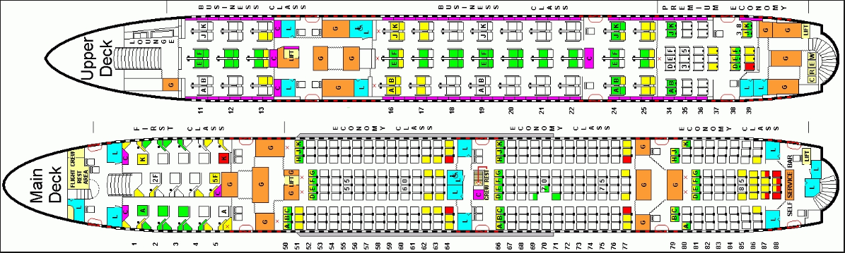
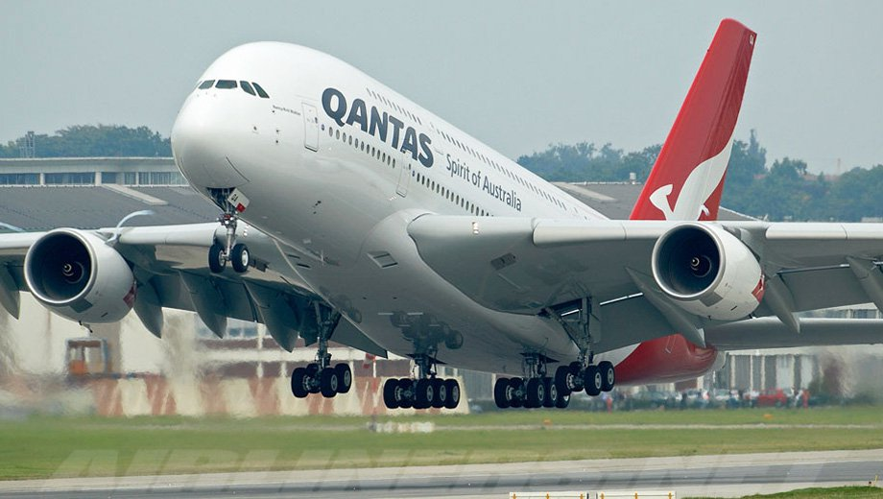
Why is tourism’s footprint so high?
Carbon intensive sector!
Plus all the factors outlined above
  Think of it like this: next time you board an Airbus 380, only 5 to 10 passengers offset their carbon emissions…
Airlines and maritime services (cruise ships) fall outside of the Paris Agreements and are self-regulated.
© Alexandra Coghlan 2019 Introduction to Sustainable Tourism

